Slide 1
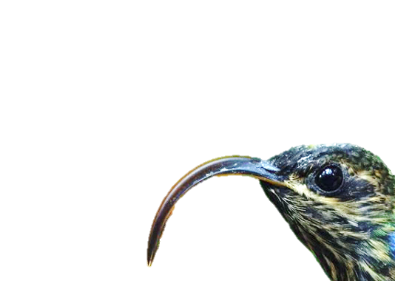
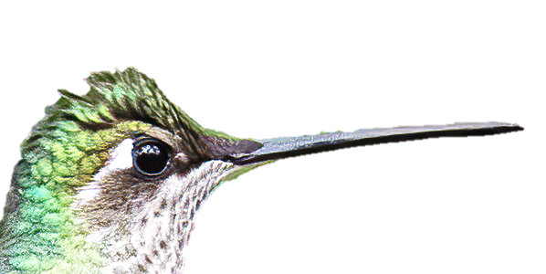
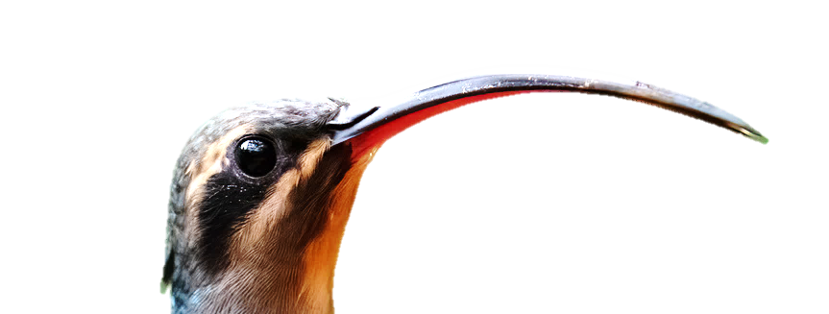
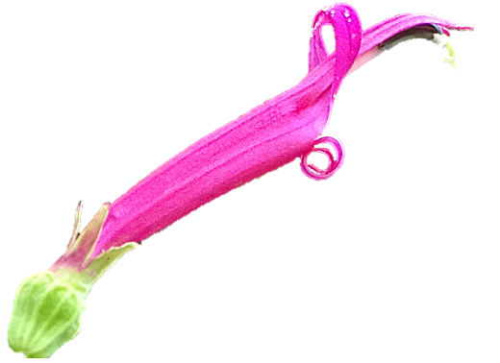
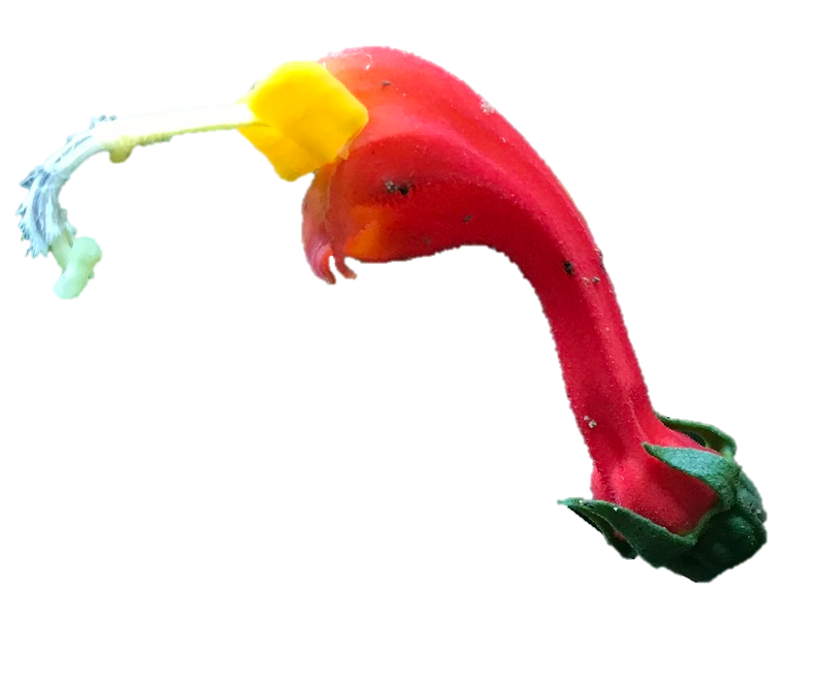
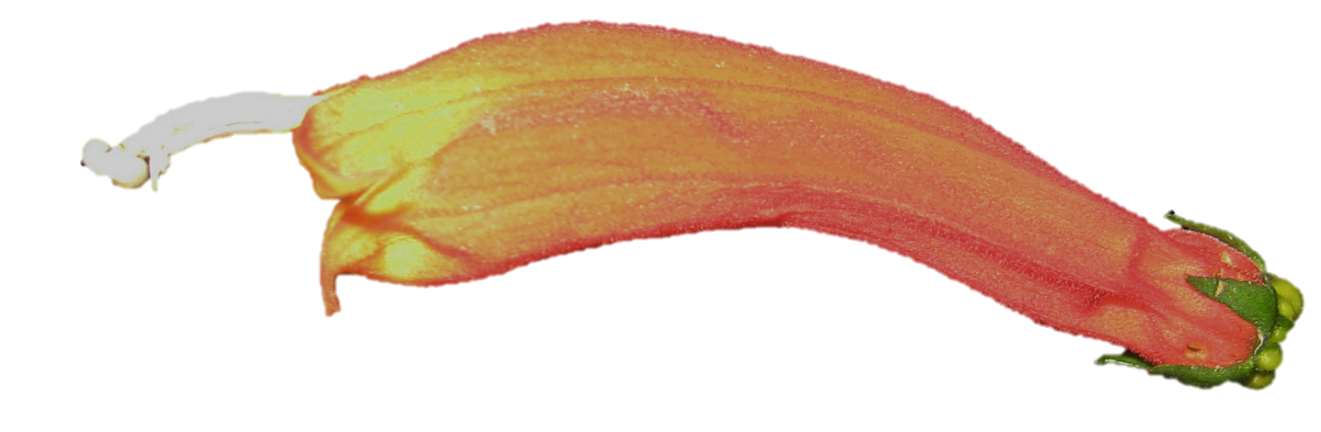
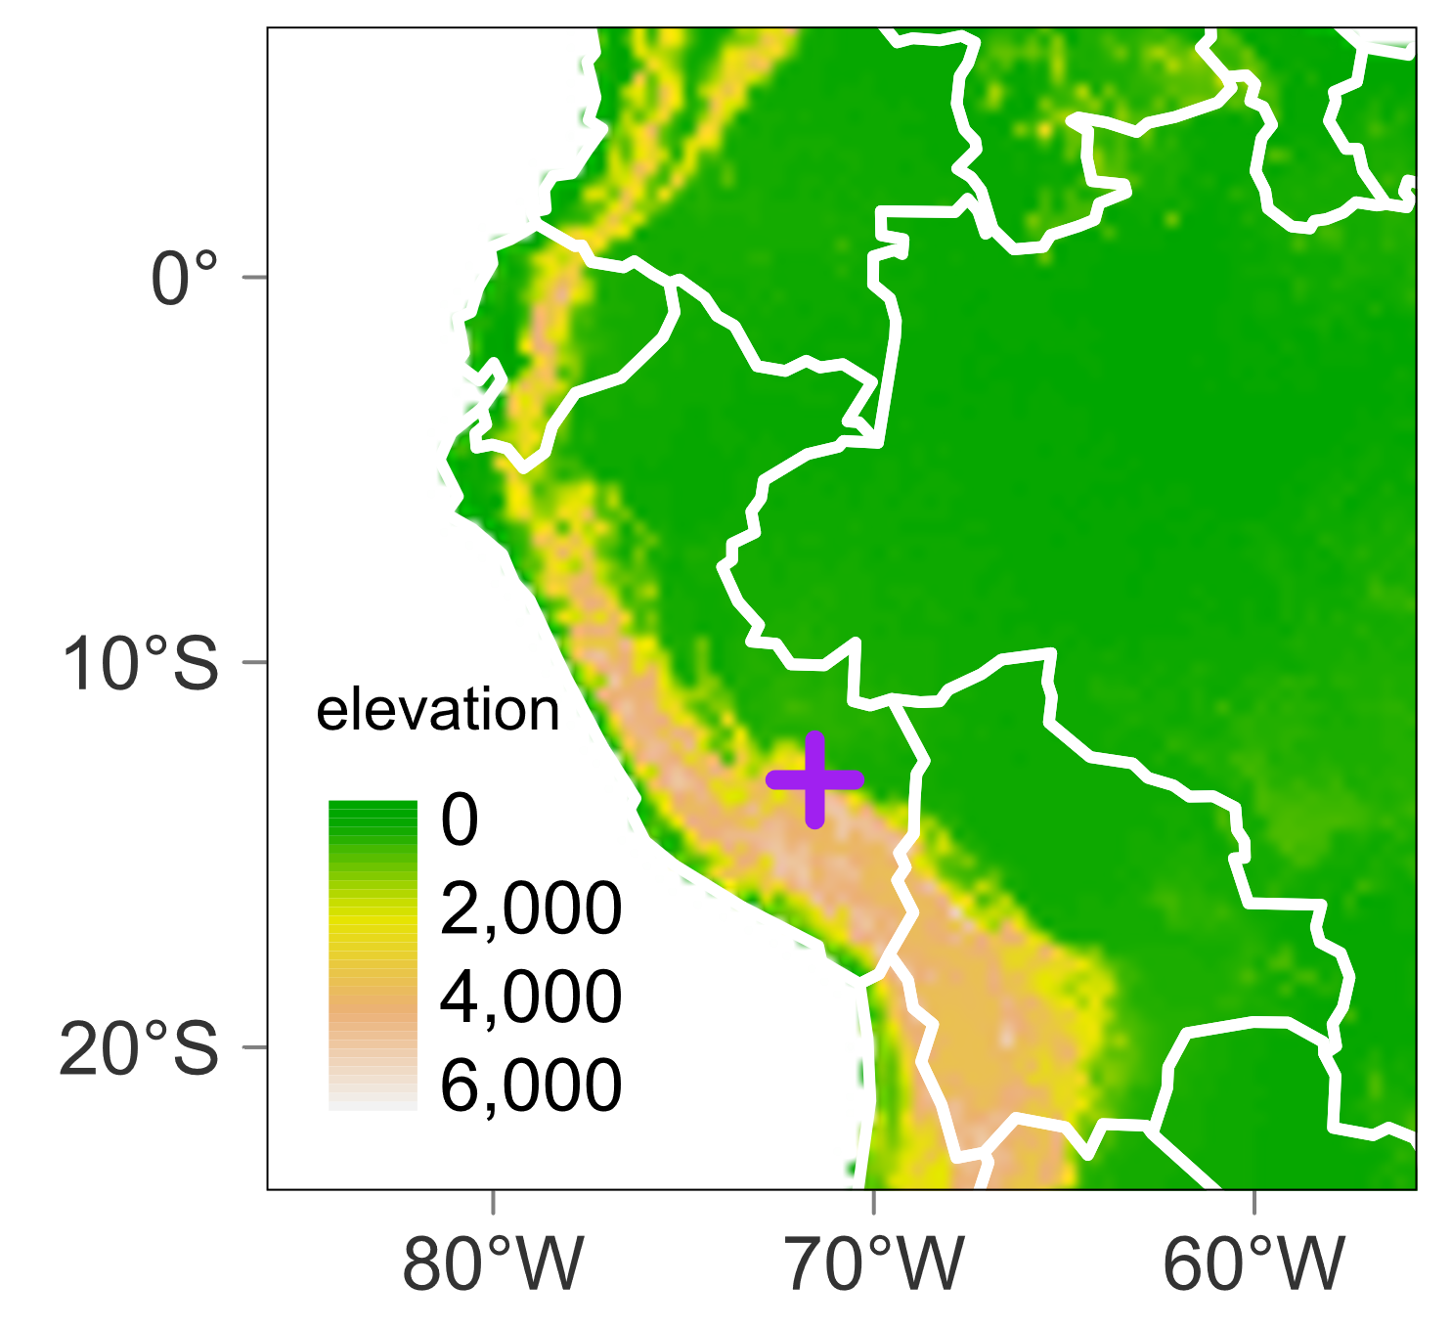
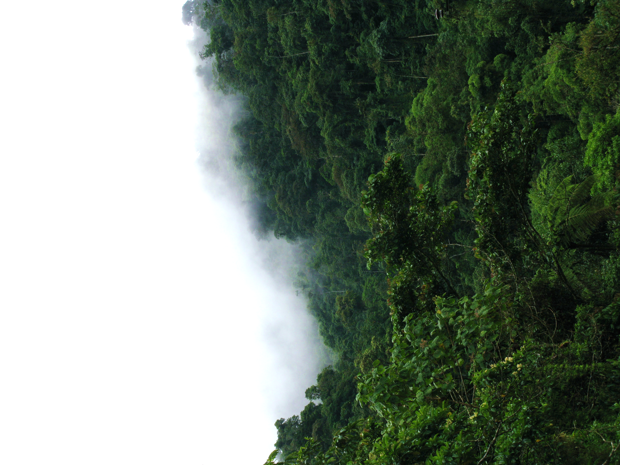
A
K_{tot} = 1.7°
K_{tot} = 51.8°
K_{tot} = 101.0°
K_{tot} = 16.0°
K_{tot} = 23.1°
K_{tot} = 121.0°
Wide (generalists)
Narrow (specialists)
Pollination Niche Width
B
C

Slide 2
A
K_{tot} = 1.7°
K_{tot} = 51.8°
K_{tot} = 101.0°
K_{tot} = 16.0°
K_{tot} = 23.1°
K_{tot} = 121.0°
Wide (generalists)
Narrow (specialists)
Pollination Niche Width
B

Slide 3
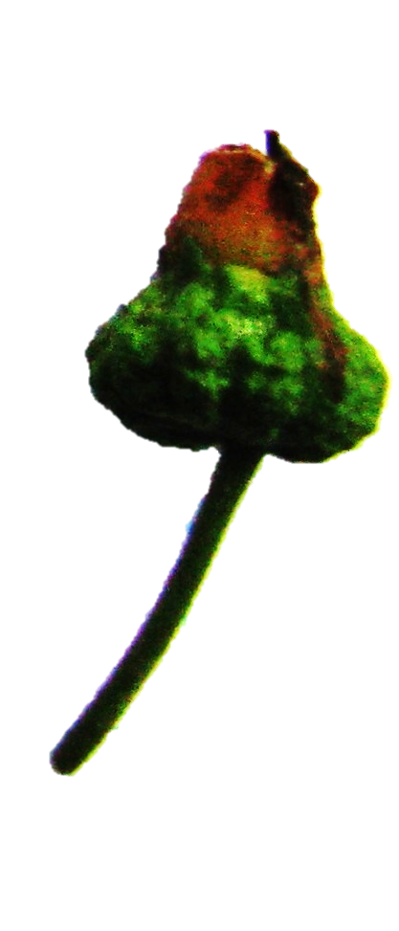
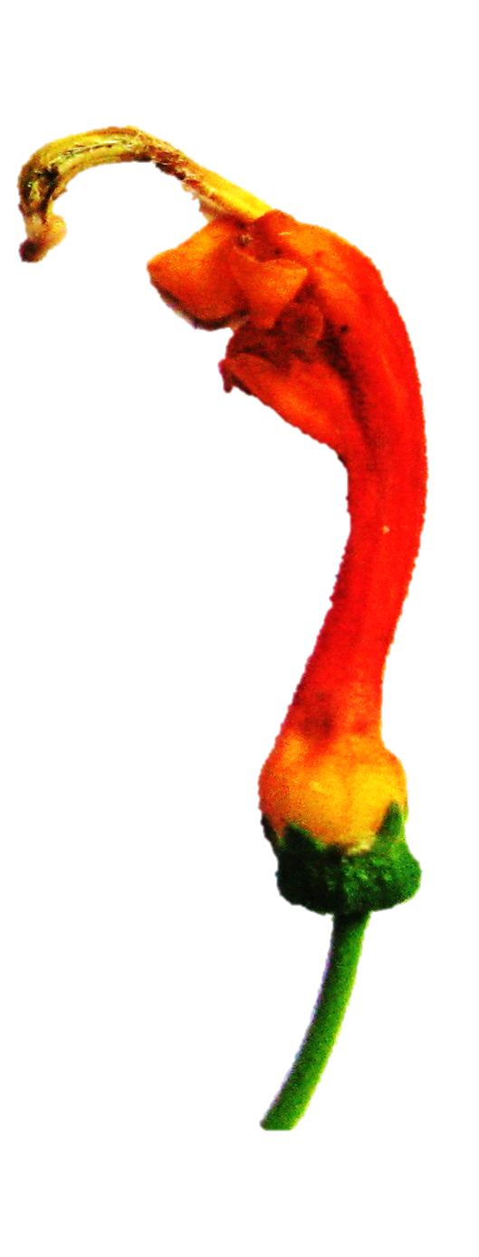
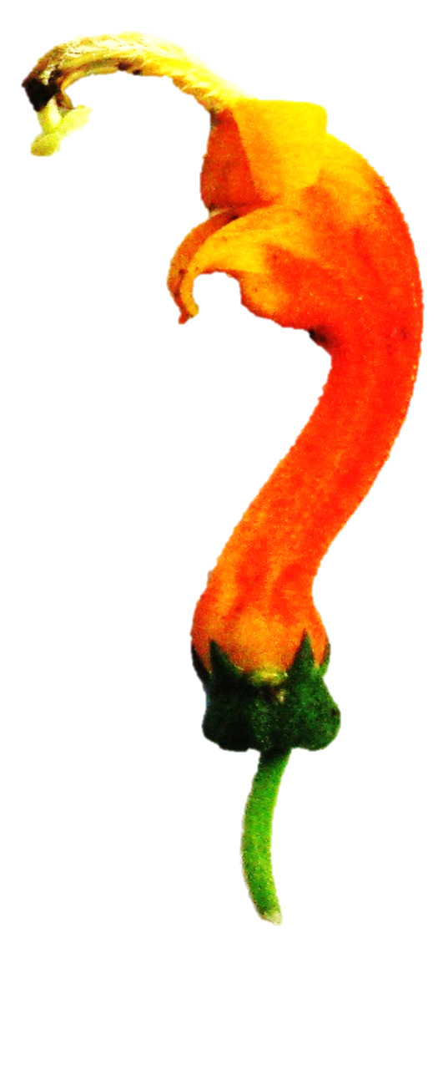
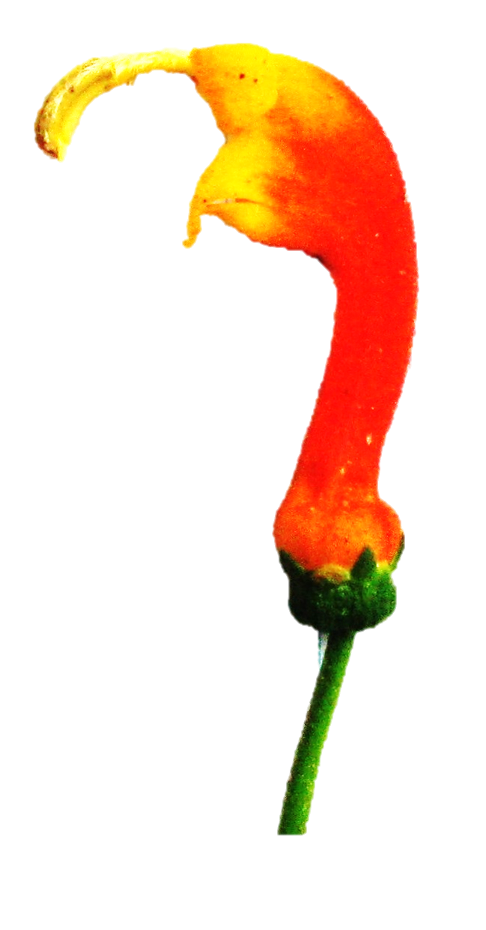
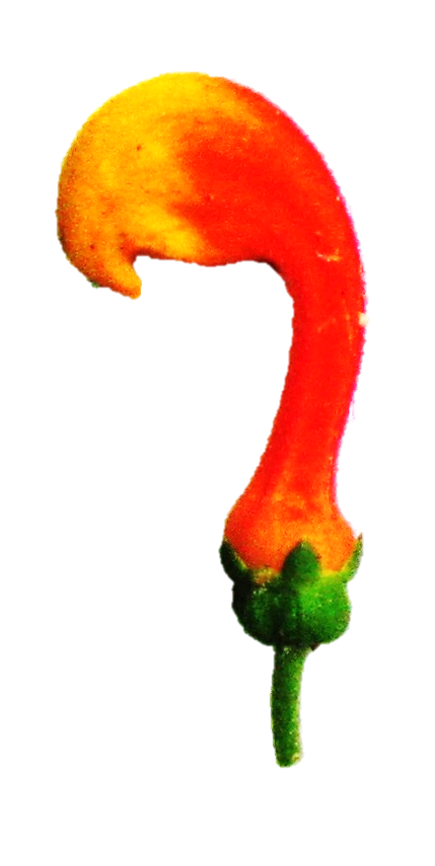
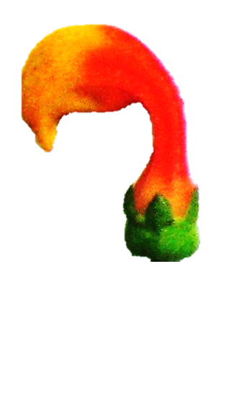
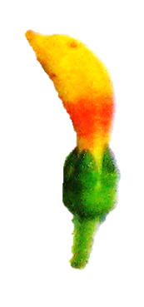
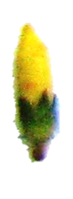
Hummingbirds excluded
Control
10 mm
70
Estimated elapsed days
50
30
A
B
C
D
E
F
G
H
Developmental Stage

Slide 4
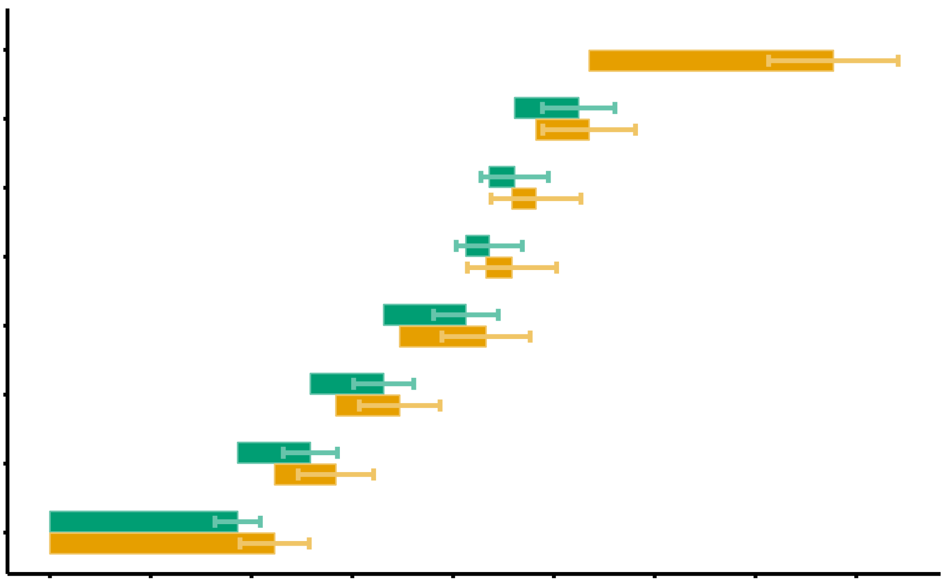
fruit
H
Hummingbirds excluded
Control
G
10 mm
F
E
♀
Developmental Stage
♂
D
C
B
A
0
10
20
30
40
50
60
70
80
Elapsed days

Slide 5
Hummingbirds excluded
Control
15
10
Number of flowers produced
5
0
0
10
20
30
Time (days)

Slide 6
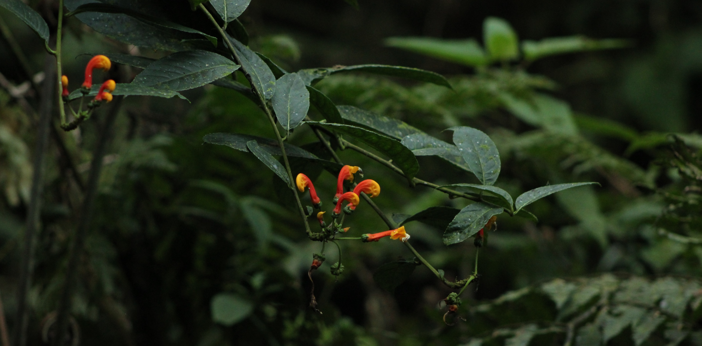
A
B
C

Slide 7
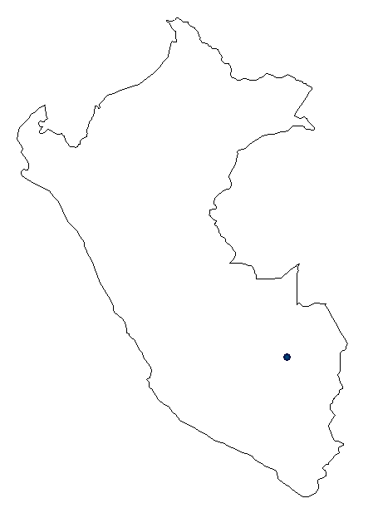
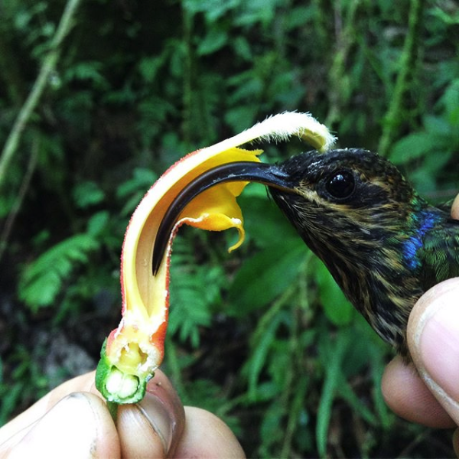
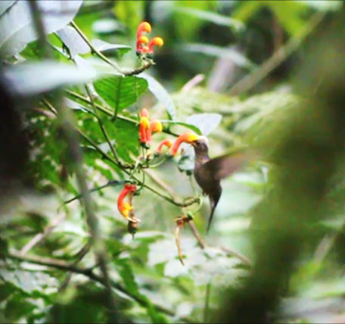
A
B
-13.05, -71.55
C
D

